Slide 1
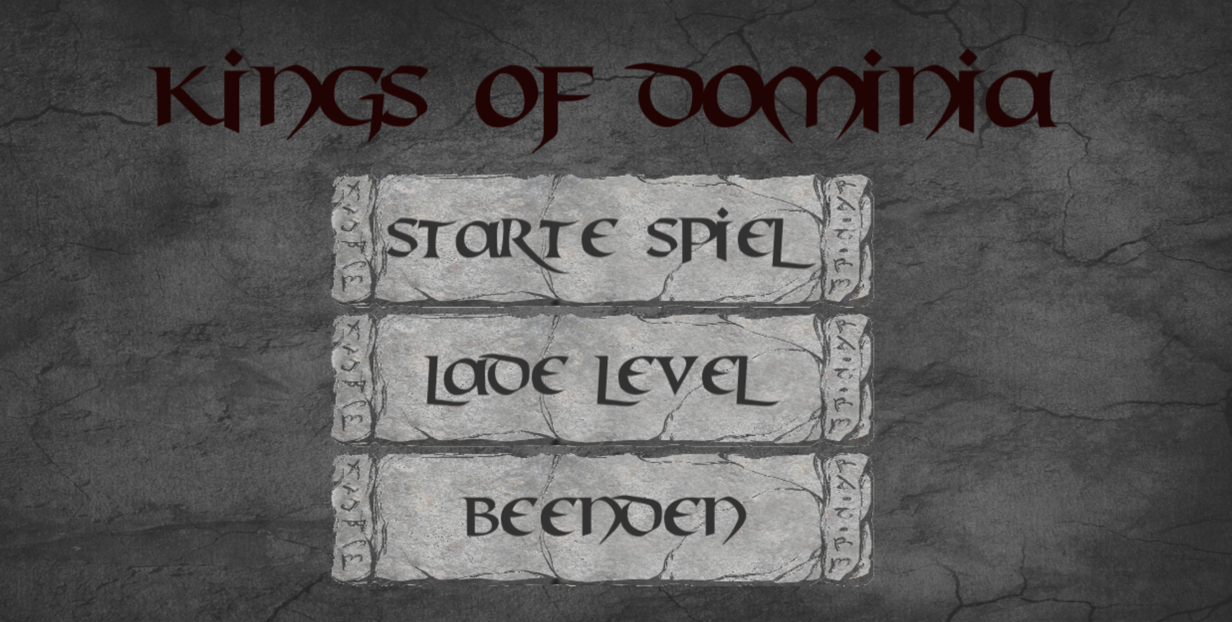
Alexander Epple
Mengdi Wang
Mohamed Taieb Ben Haddej

Slide 2

Game Mechanic
Basic:
One start point, one end point
Place dominos between start point and end point
Hit the first point → all dominos pushed down one by one
Get the end point hit → you win the game!
Advanced:
You may need different types of dominos! (taller? ice? explosion?)
You can make use of cannons (watch out for shooting direction!)
You have to open the gates sometimes (something hits the gates trigger!)
Dominos can push a ball ⬅➔ a ball can also push dominos!

Slide 3
Basic: for rookie
The most basic operations (on touch screen devices):
touch buttons (normally with one finger)
touch screen with two fingers and rotate fingers <==> rotate view direction
touch screen with two fingers and split fingers up / move fingers closer <==> camera zoom out / in

Slide 4
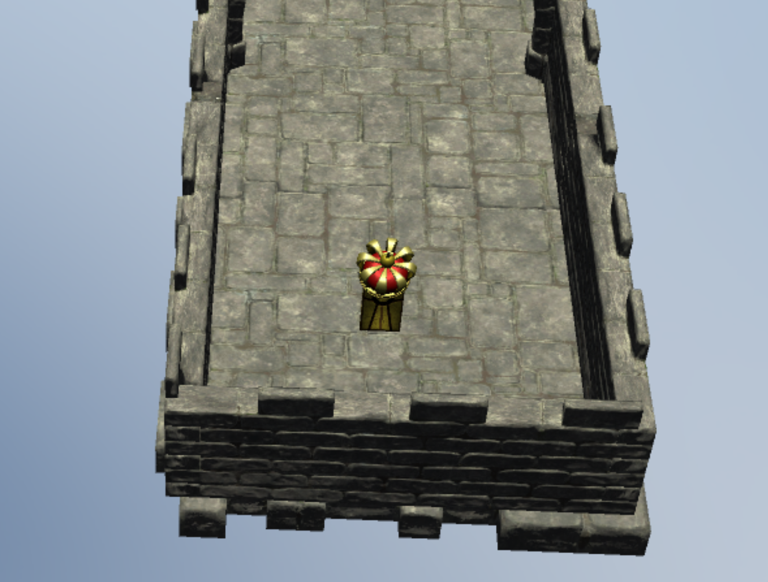
Basic: start point
A yellow domino with a crown
In normal mode:
touch this domino
<==> add a force in your view direction
<==> push the domino down
That‘s why this domino is start point!

Slide 5
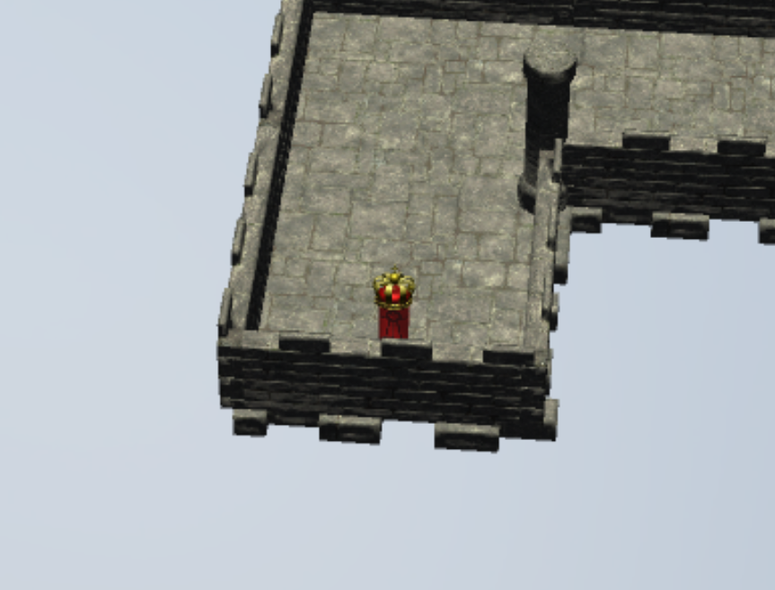
Basic: end point
A red domino with a crown
Get this domino hit
<==> you win the game! (at least this level)

Slide 6
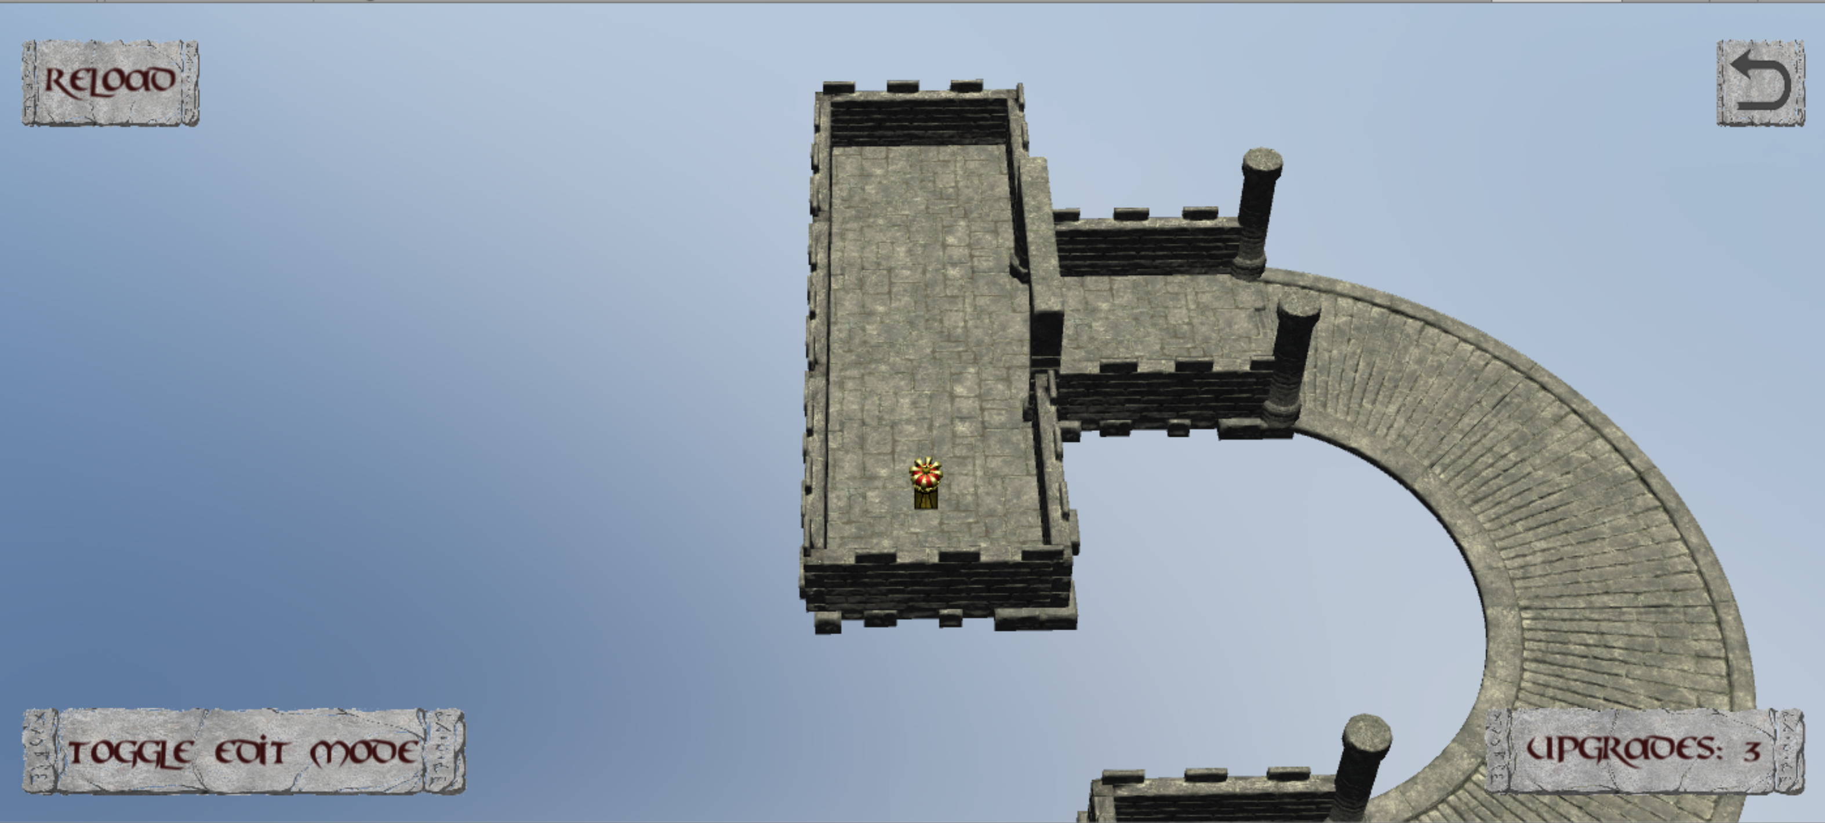
Basic: normal mode
Camera looks onto the level with some angle to horizon
You can:
touch start point <==> push it down!
touch “toggle edit mode” <==> switch to edit mode!

Slide 7
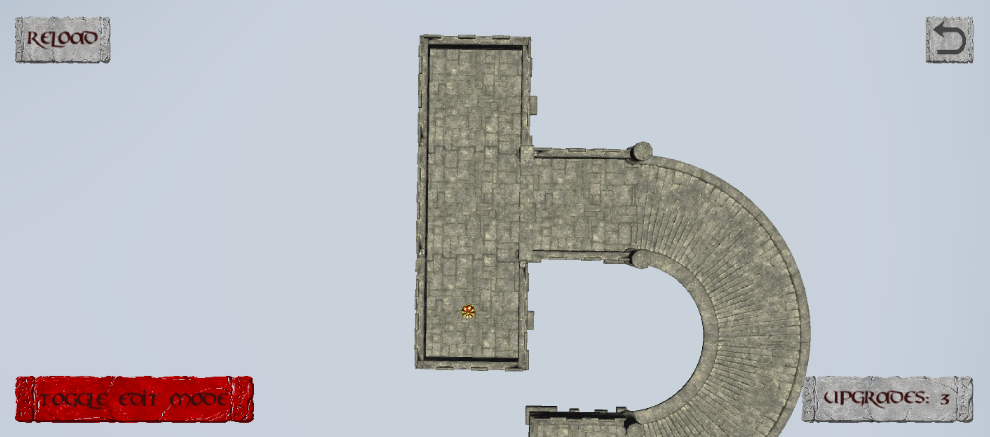
Basic: edit mode
Camera looks onto the level vertically
You can:
place dominos
upgrade dominos
revert operation to dominos
adjust cannon direction
touch “toggle edit mode” <==> quit edit mode

Slide 8
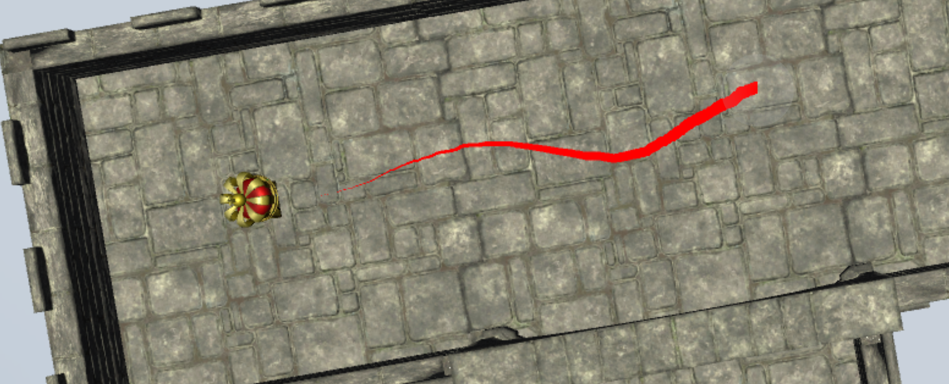
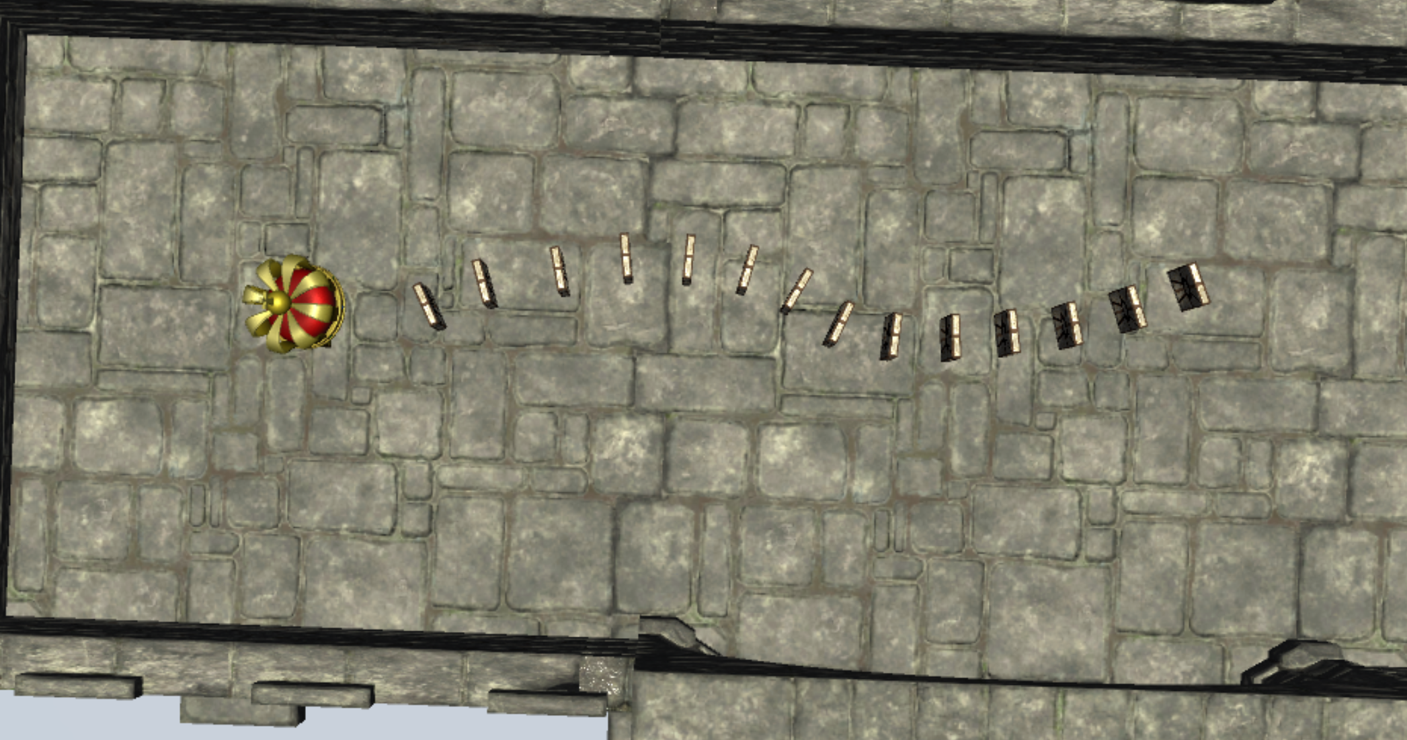
Basic: place dominos
How to place dominos in edit mode?
touch the level with one finger
drag on the level, you will see a red line
loose your finger, and you will get dominos spawned along the line

Slide 9
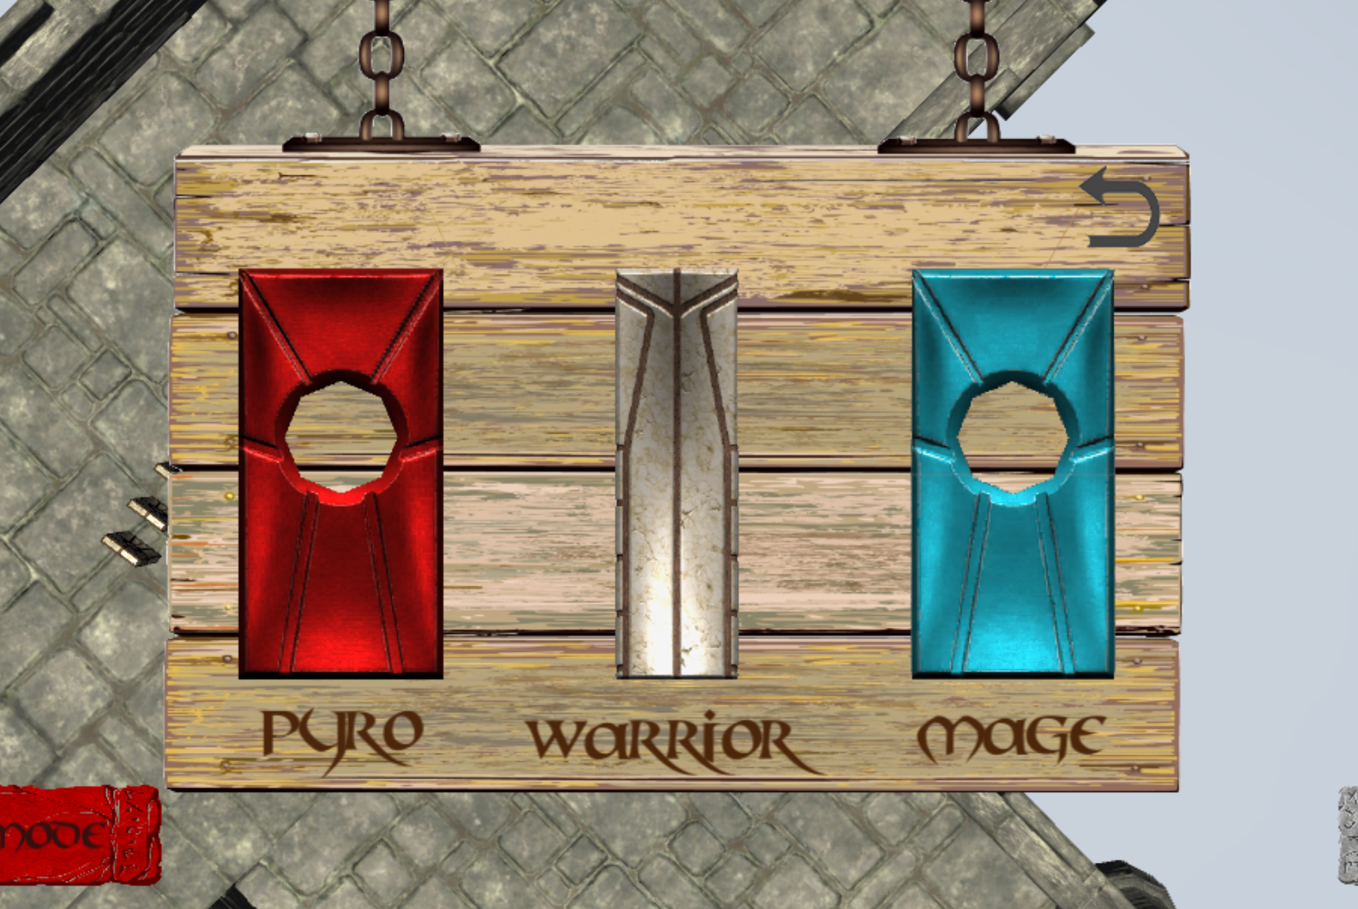
Advanced: upgrade dominos
How to upgrade dominos in edit mode?
touch the domino you want to upgrade
hold on for more than 0.5 sec
choose one type ☺ pyro: blast on touch to wall warrior: taller than other mage: made of ice, can skate

Slide 10
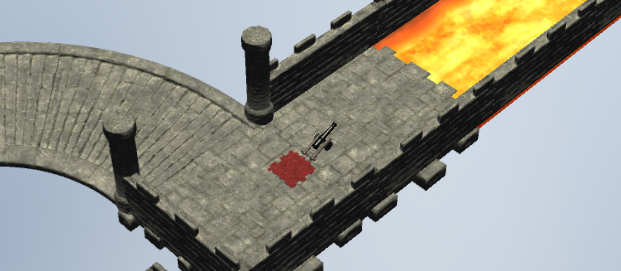
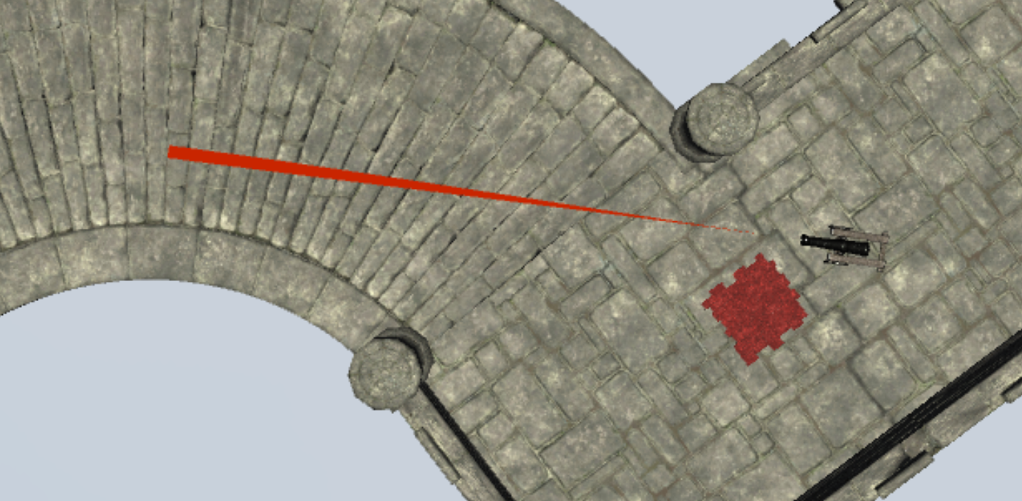
Advanced: cannon
Cannon: shoot bullet
Cannon has a red trigger. If the trigger is hit by dominos or by bullet: shooting!!!
In edit mode:
a red line shows shooting trail
touch the cannon, then you can adjust its shooting direction with two fingers
touch somewhere else: stop adjusting cannon

Slide 11
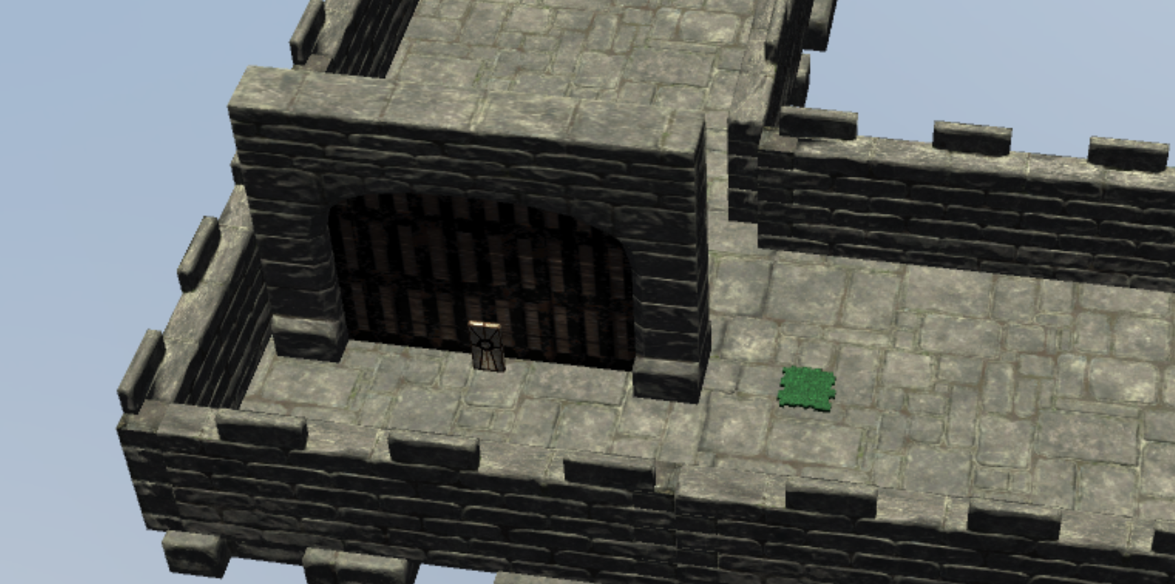
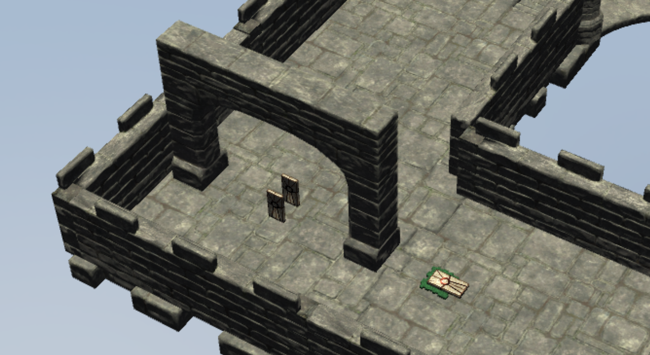
Advanced: gate
Gate has a green trigger. If the trigger is hit by dominos: open the gate!!!
Hint:
The trigger to the gate might not be closed to gate, rather somewhere else! So look for it!!!

Slide 12
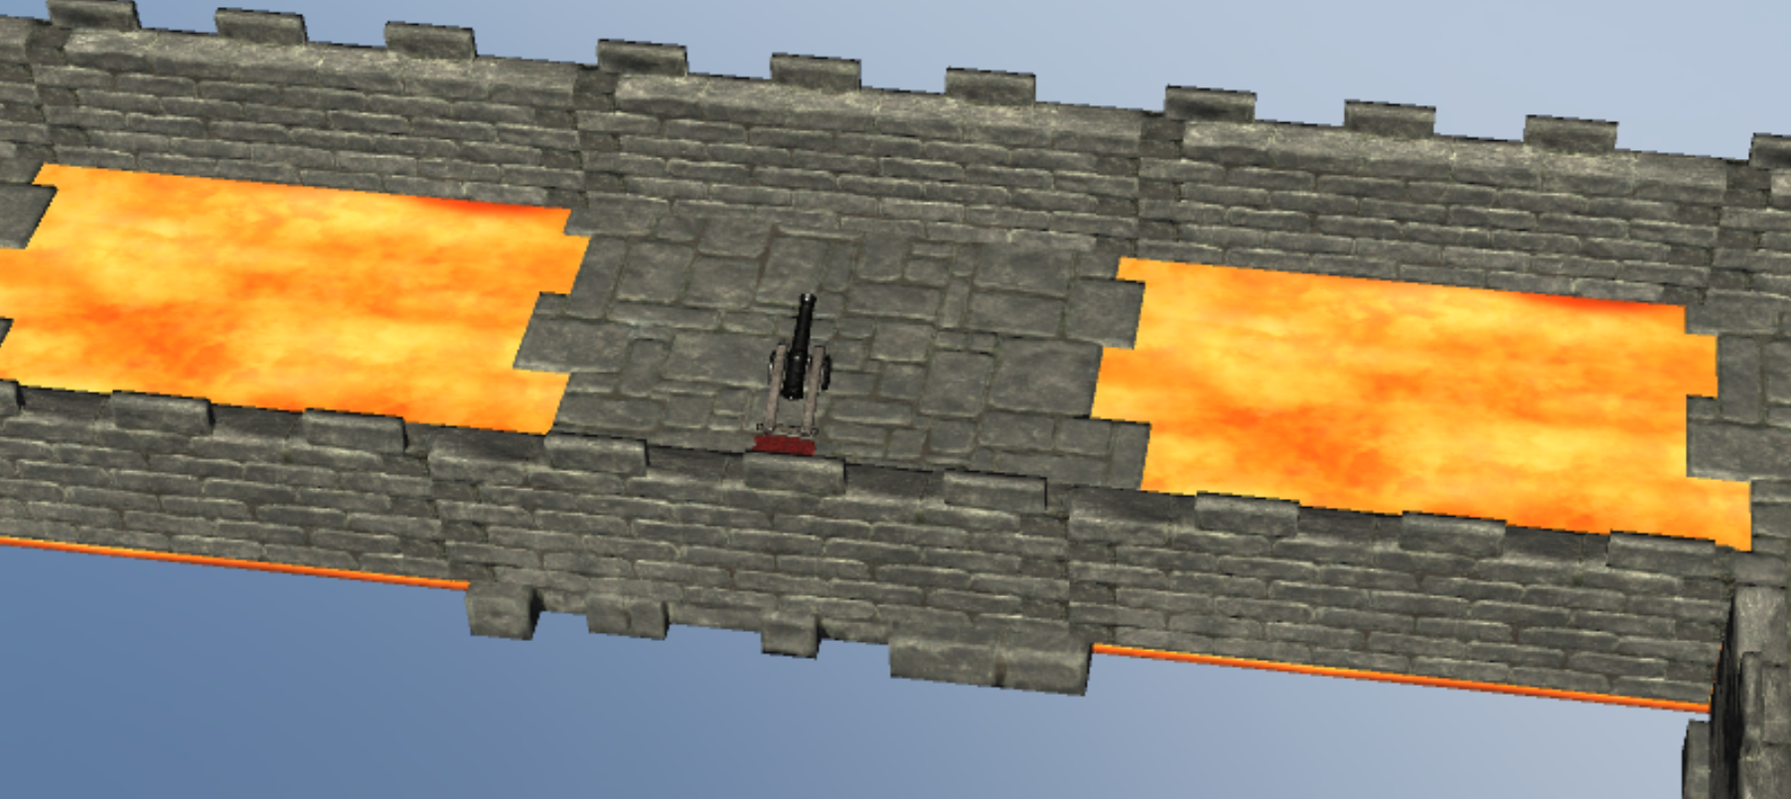
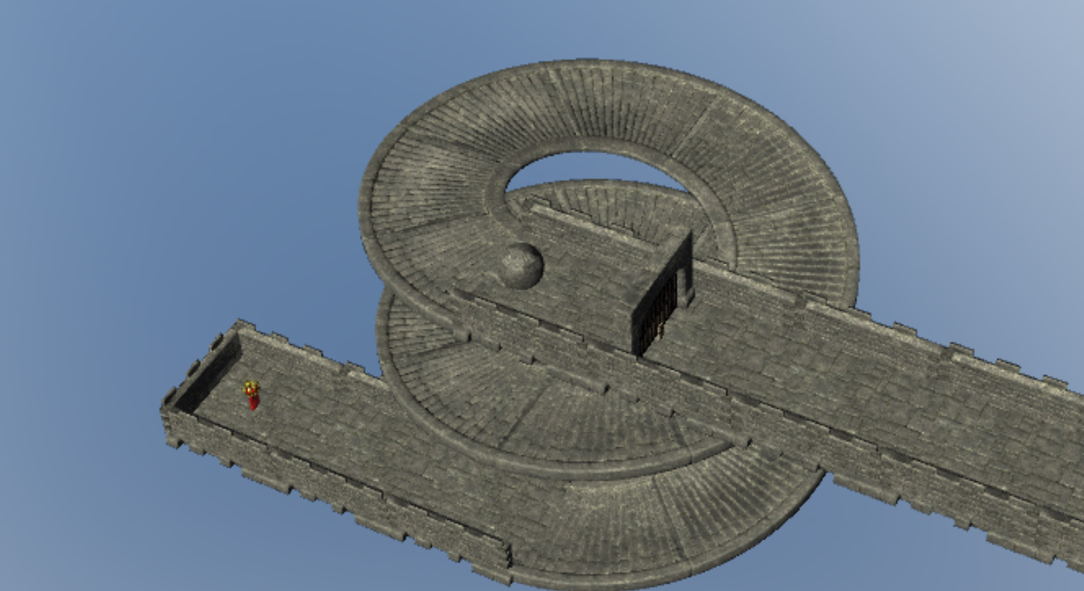
Tips
Of course, you can’t place dominos everywhere! For example:
in the sky
on the wall, gate
on the lava river
on the slide
If you have to go through them, pls try:
round away
use cannons
use different advanced domino types

Slide 13
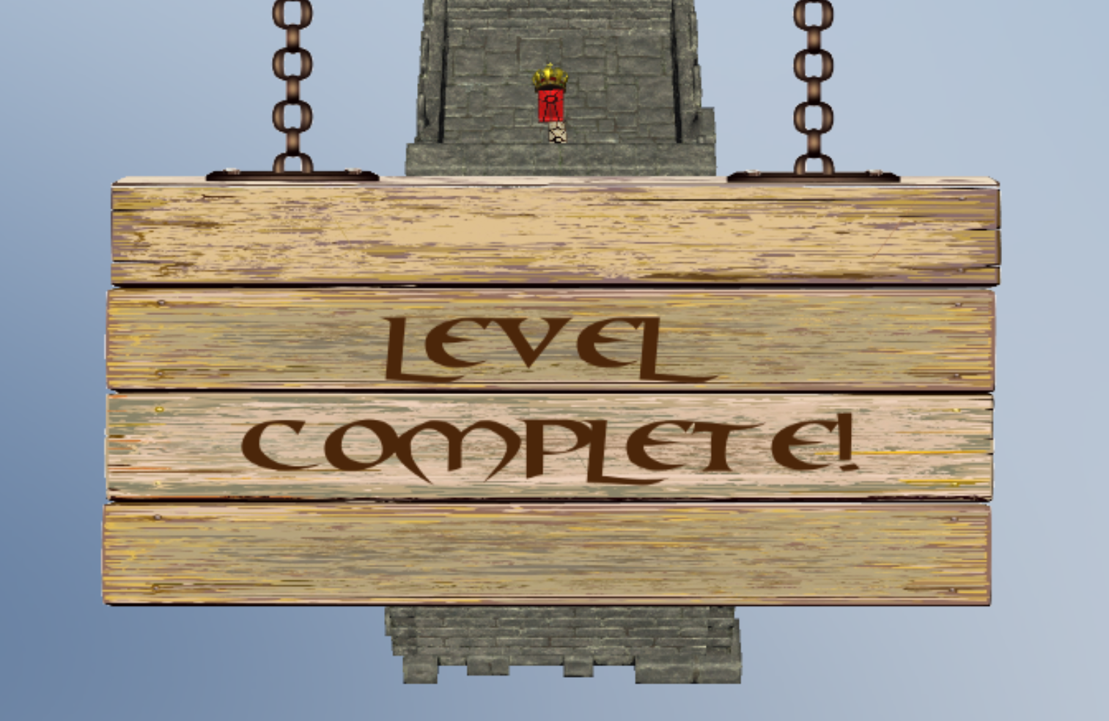
Enjoy your game! ☺

